Slide 1
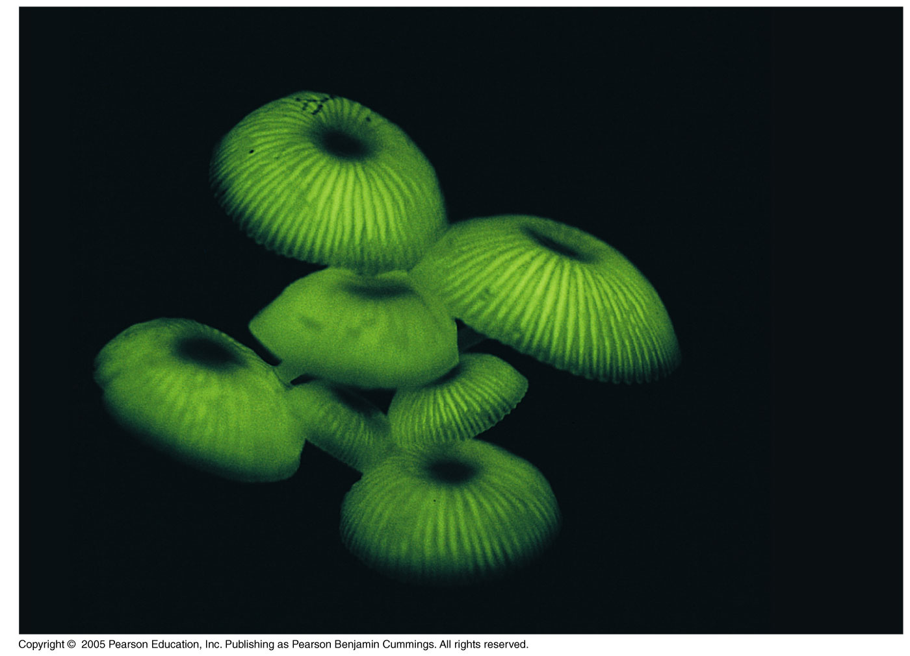
Figure 8-01

Slide 2
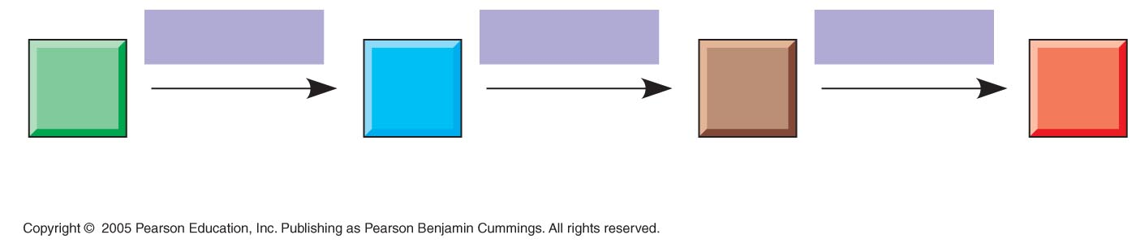
LE 8-UN141
Enzyme 1
Enzyme 2
Enzyme 3
A
B
C
D
Reaction 1
Reaction 2
Reaction 3
Starting
molecule
Product

Slide 3
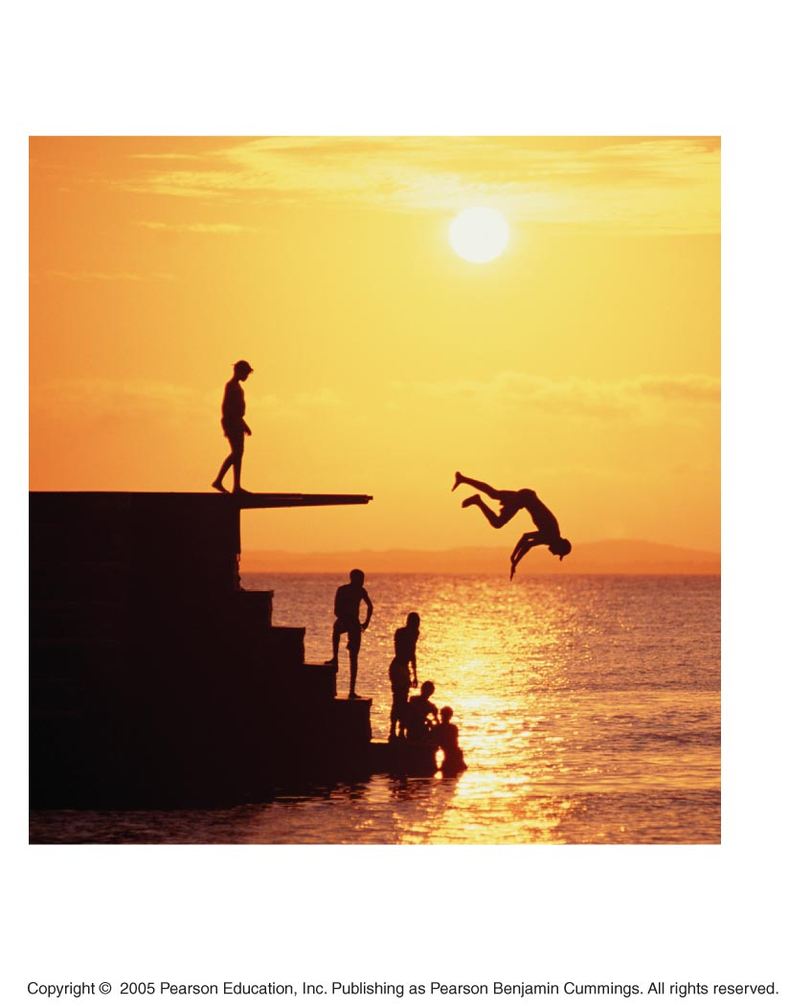
LE 8-2
On the platform,
the diver has
more potential
energy.
Diving converts
potential
energy to
kinetic energy.
Climbing up converts
kinetic energy of
muscle movement to
potential energy.
In the water, the
diver has less
potential energy.

Slide 4
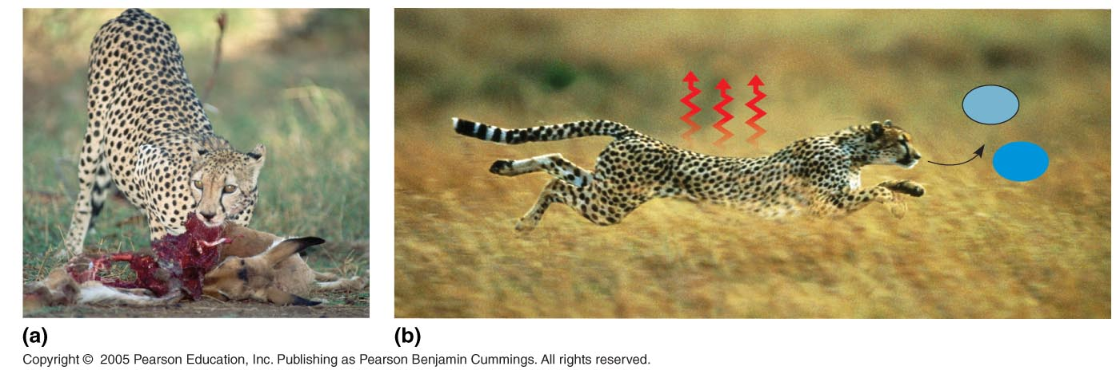
LE 8-3
Chemical
energy
Heat
CO₂
H₂O
First law of thermodynamics
Second law of thermodynamics

Slide 5
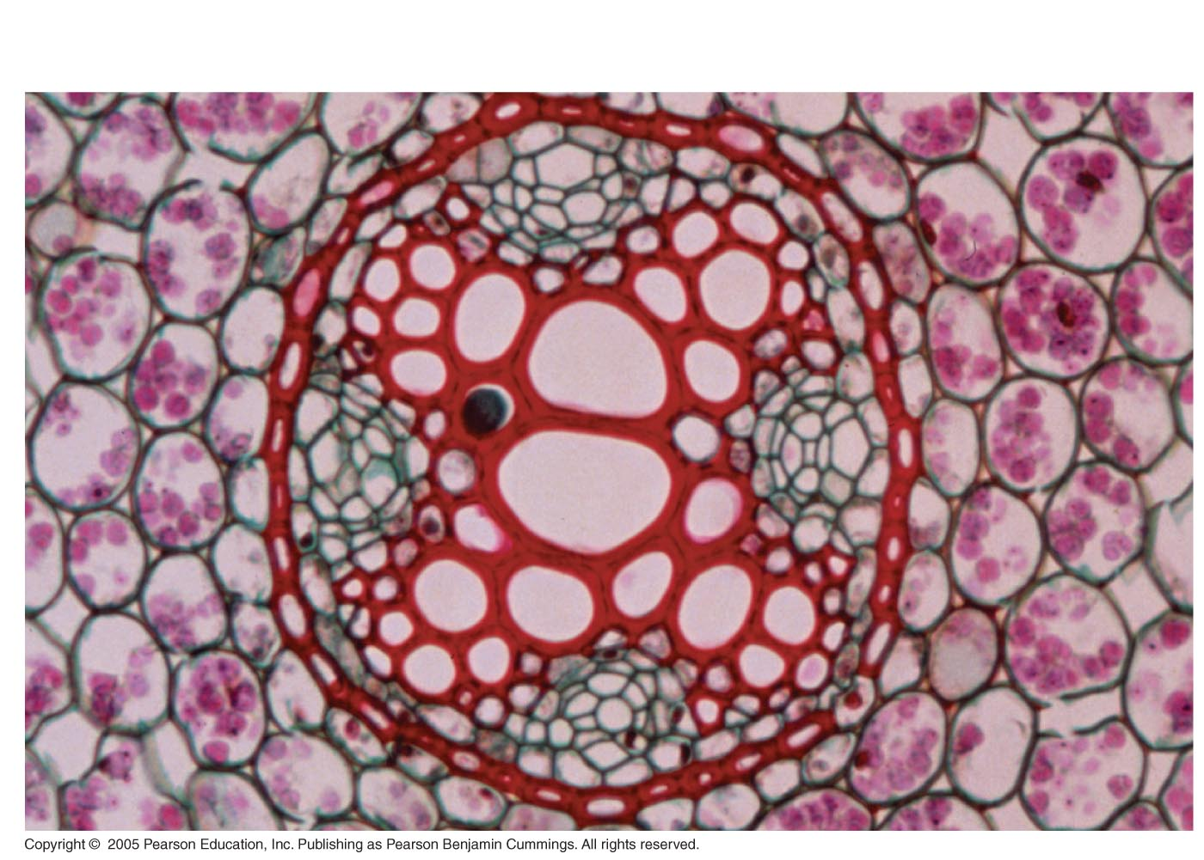
LE 8-4
50 µm

Slide 6
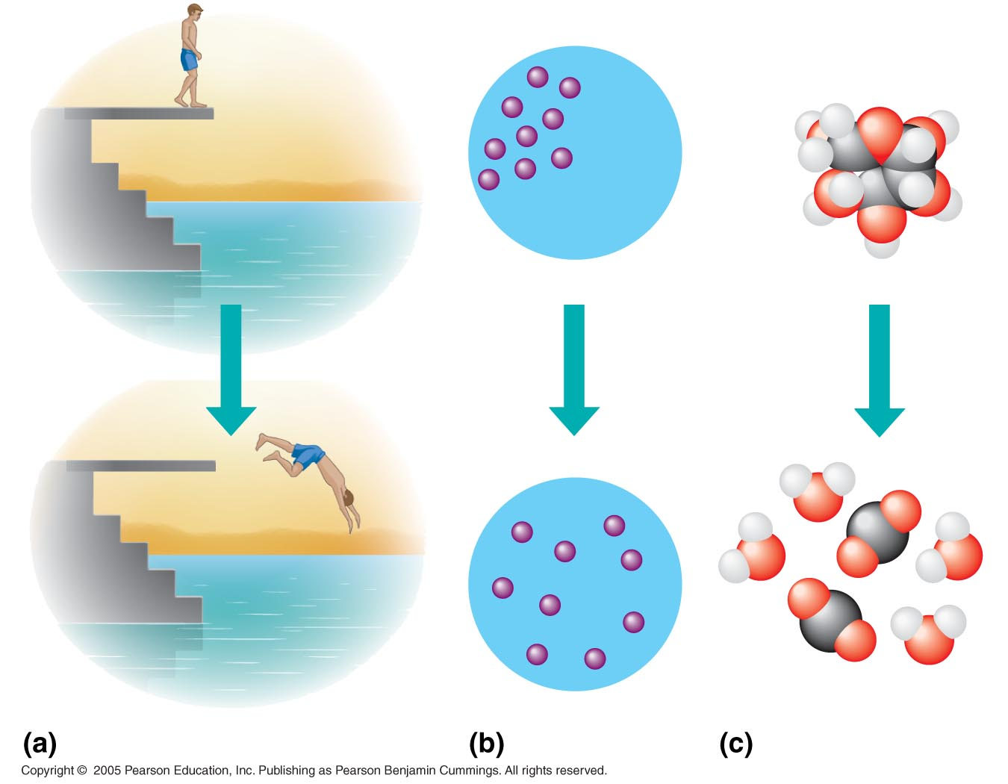
LE 8-5
Gravitational motion
Diffusion
Chemical reaction

Slide 7
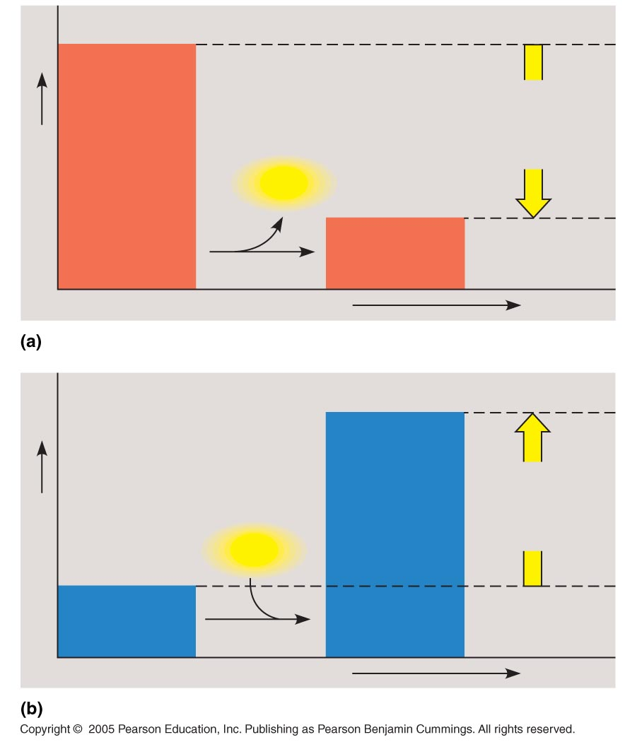
LE 8-6
Reactants
Amount of
energy
released
(ΔG < 0)
Free energy
Energy
Products
Progress of the reaction
Exergonic reaction: energy released
Products
Amount of
energy
required
(ΔG < 0)
Free energy
Energy
Reactants
Progress of the reaction
Endergonic reaction: energy required

Slide 8
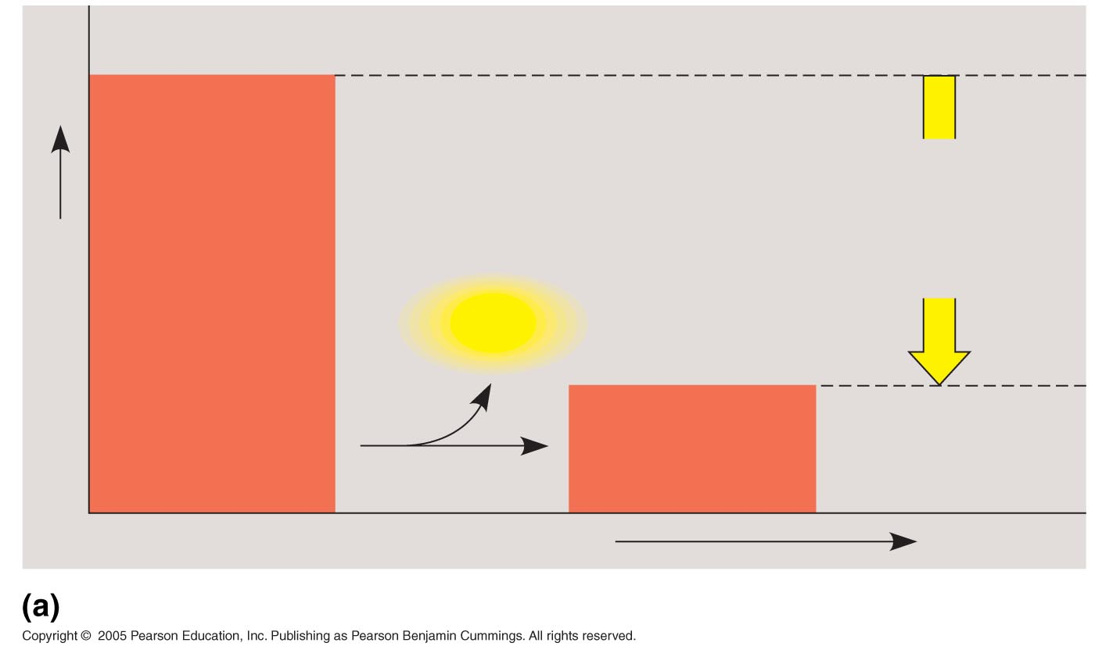
LE 8-6a
Reactants
Amount of
energy
released
(ΔG < 0)
Free energy
Energy
Products
Progress of the reaction
Exergonic reaction: energy released

Slide 9
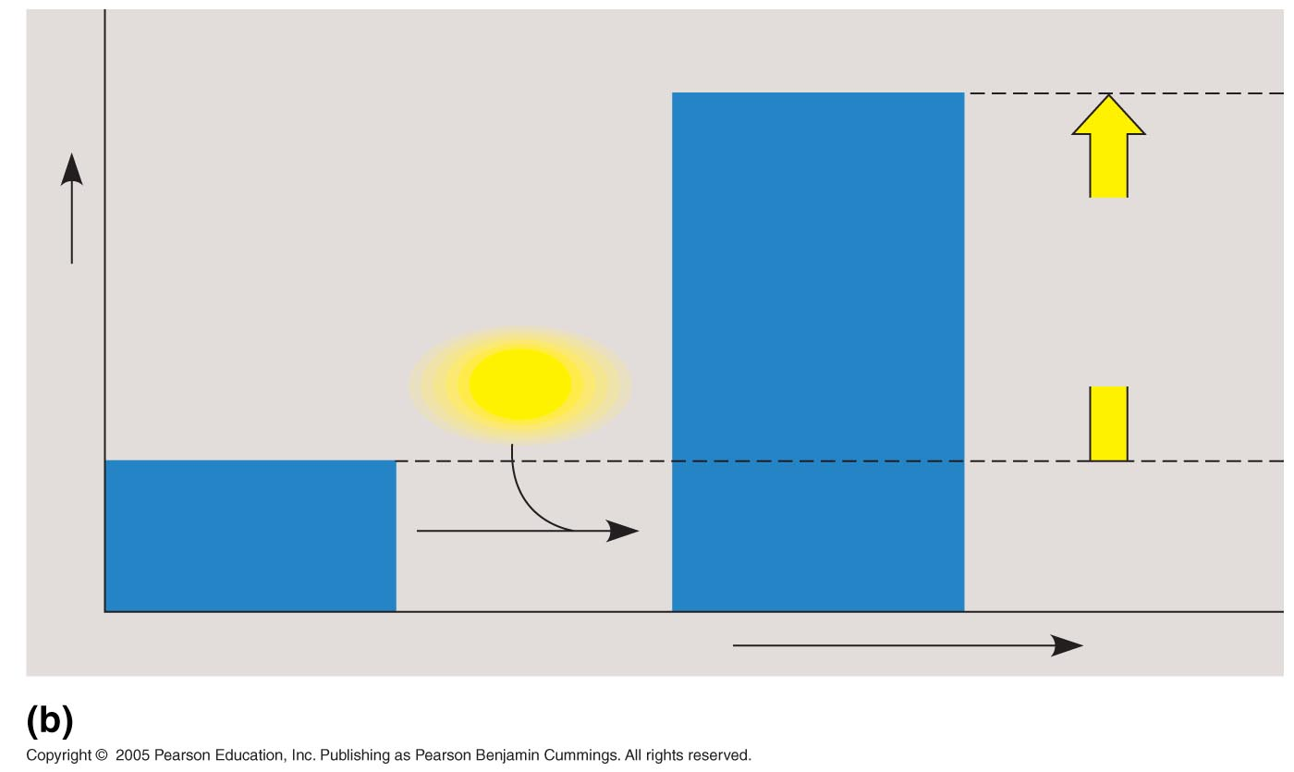
LE 8-6b
Products
Amount of
energy
required
(ΔG > 0)
Free energy
Energy
Reactants
Progress of the reaction
Endergonic reaction: energy required

Slide 10
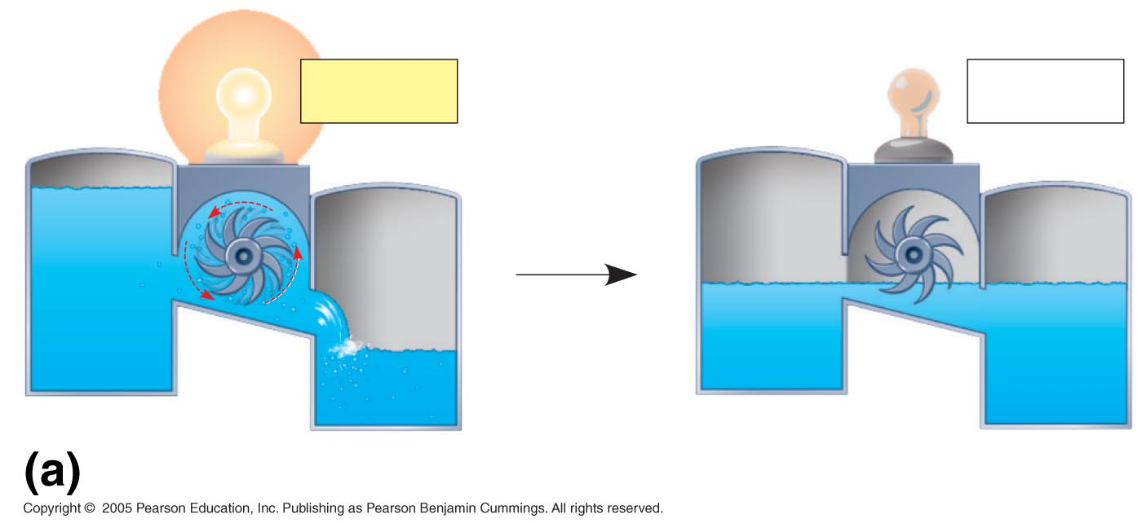
LE 8-7a
ΔG < 0
ΔG = 0
A closed hydroelectric system

Slide 11
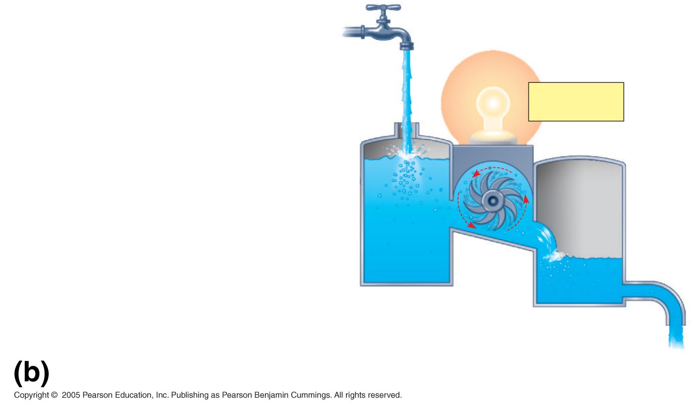
LE 8-7b
ΔG < 0
An open hydroelectric system

Slide 12
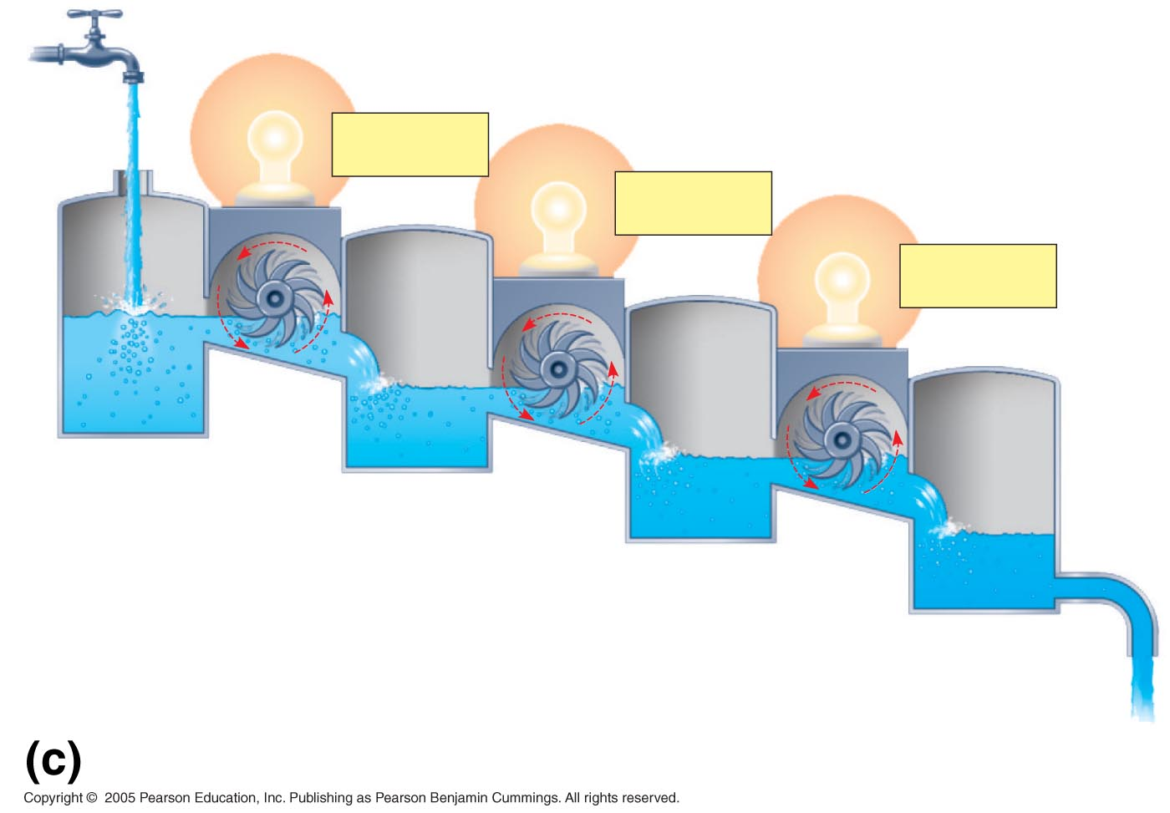
LE 8-7c
ΔG < 0
ΔG < 0
ΔG < 0
A multistep open hydroelectric system

Slide 13
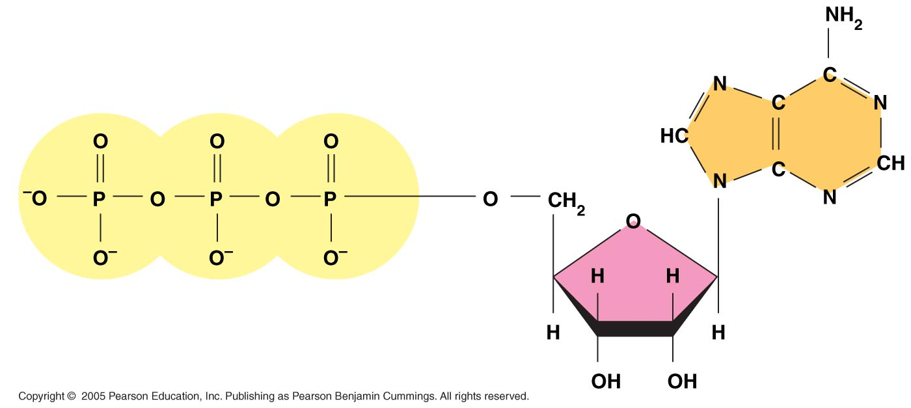
LE 8-8
Adenine
Phosphate groups
Ribose

Slide 14
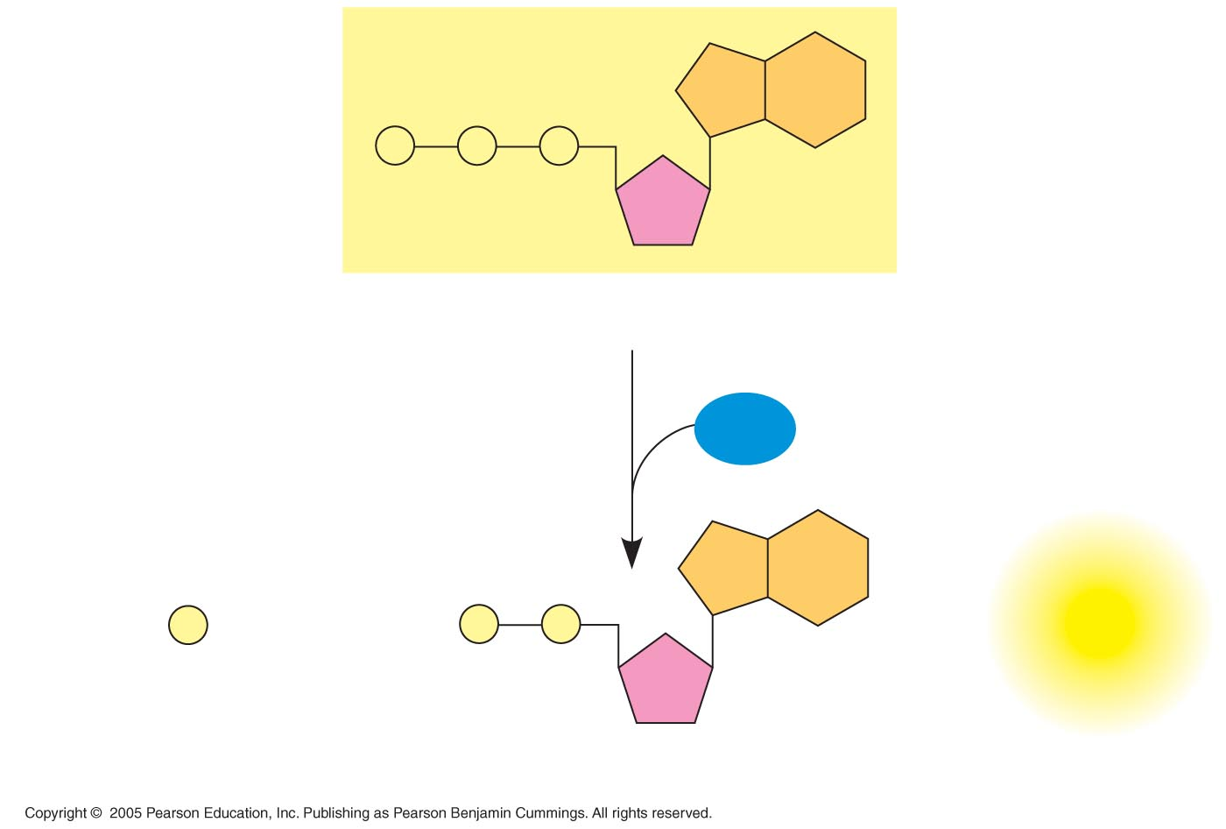
LE 8-9
P
P
P
Adenosine triphosphate (ATP)
H₂O
P
+
P
P
+
Energy
i
Inorganic phosphate
Adenosine diphosphate (ADP)

Slide 15
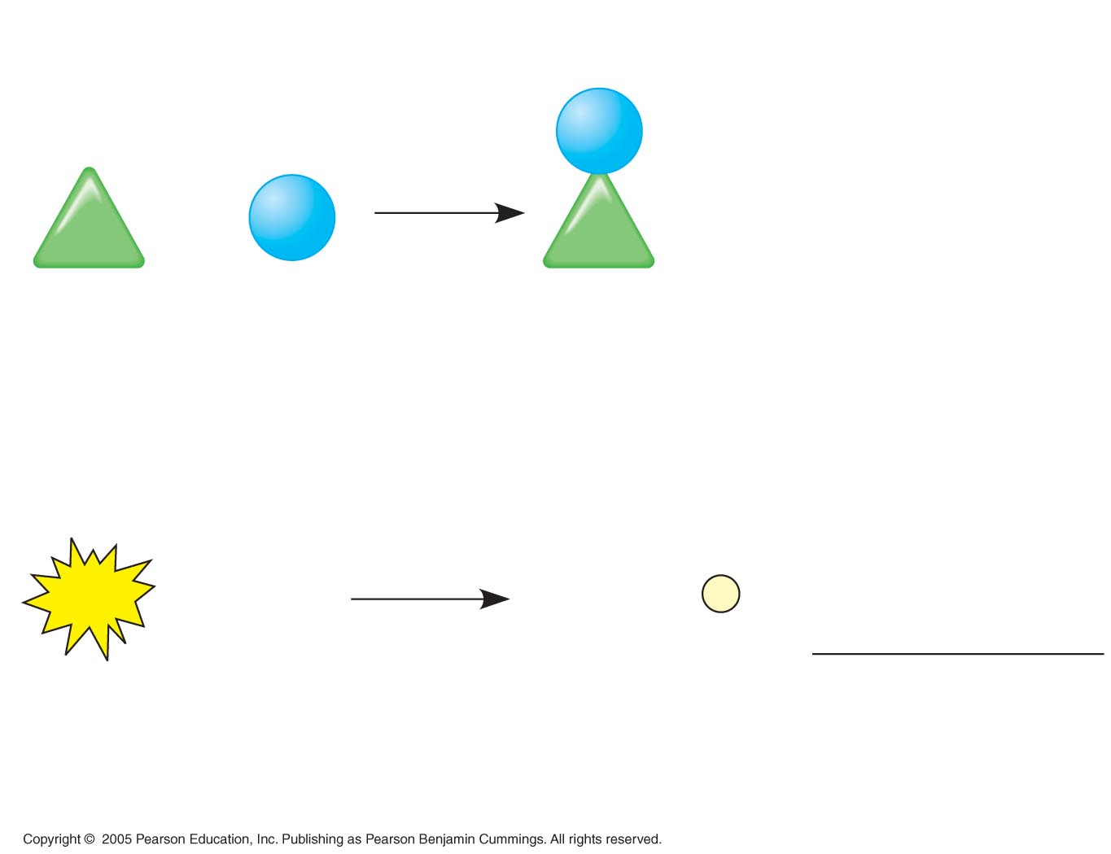
LE 8-10
Endergonic reaction: ΔG is positive, reaction
is not spontaneous
NH₂
+
NH₃
ΔG = +3.4 kcal/mol
Glu
Glu
Glutamic
acid
Ammonia
Glutamine
Exergonic reaction: ΔG is negative, reaction
is spontaneous
ATP
+
H₂O
ADP
+
P
i
ΔG = –7.3 kcal/mol
Coupled reactions: Overall ΔG is negative;
together, reactions are spontaneous
ΔG = –3.9 kcal/mol

Slide 16
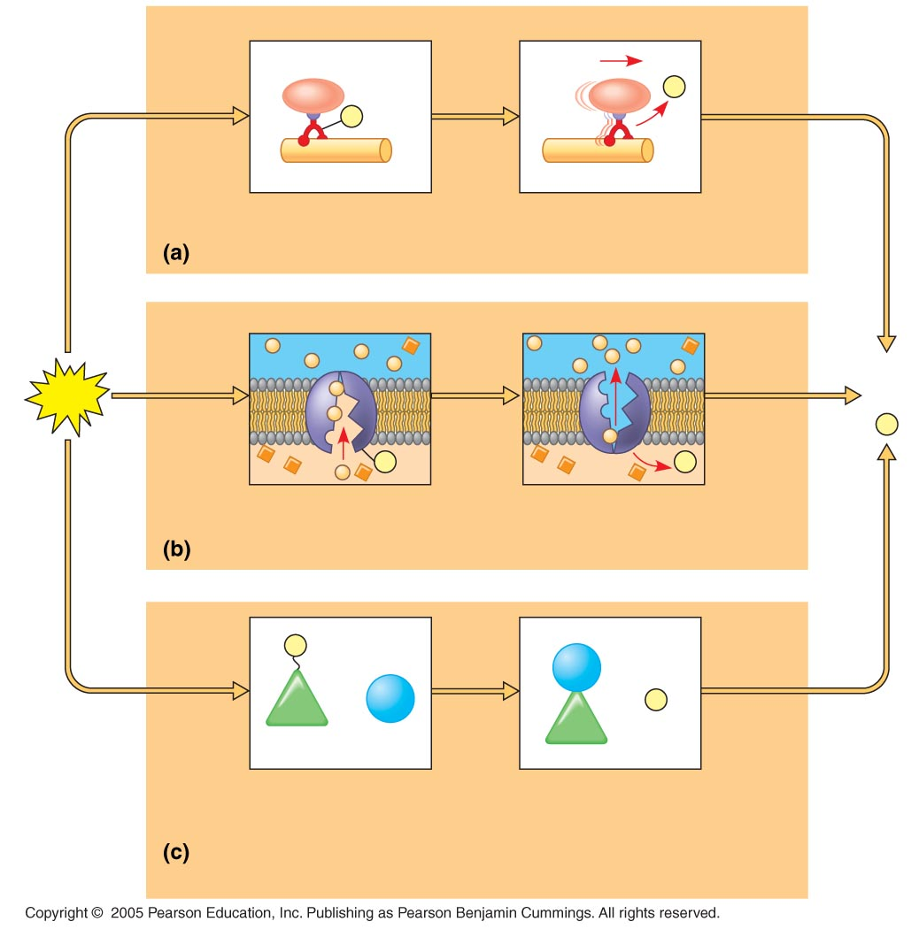
LE 8-11
P
i
P
Motor protein
Protein moved
Mechanical work: ATP phosphorylates motor proteins
Membrane
protein
ADP
ATP
+
P
i
P
P
i
Solute
Solute transported
Transport work: ATP phosphorylates transport proteins
P
NH₂
Glu
+
NH₃
+
P
i
Glu
Reactants: Glutamic acid
and ammonia
Product (glutamine)
made
Chemical work: ATP phosphorylates key reactants

Slide 17
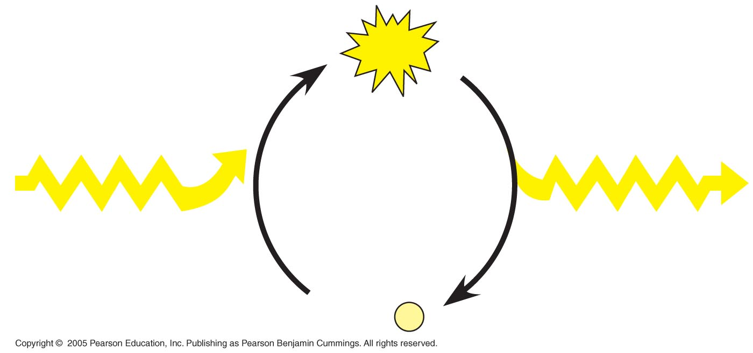
LE 8-12
ATP
Energy from catabolism
(energonic, energy-
yielding processes)
Energy for cellular work
(endergonic, energy-
consuming processes)
ADP
+
P
i

Slide 18
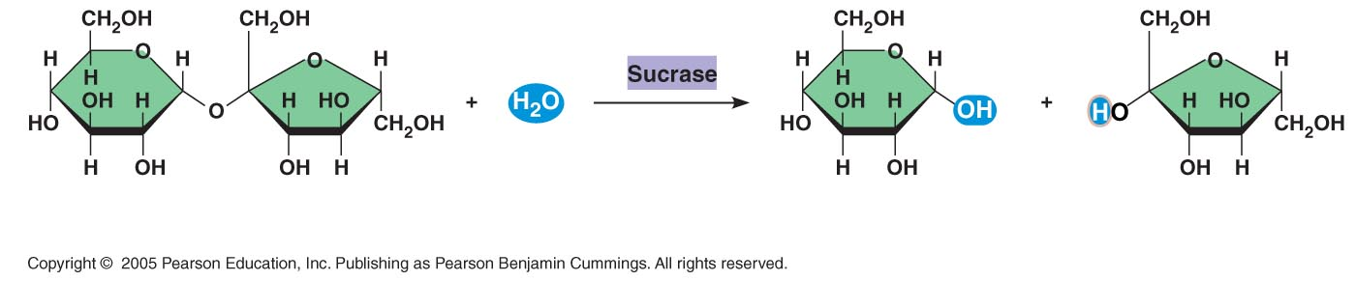
LE 8-13
Sucrose
C₁₂H₂₂O₁₁
Glucose
C₆H₁₂O₆
Fructose
C₆H₁₂O₆

Slide 19
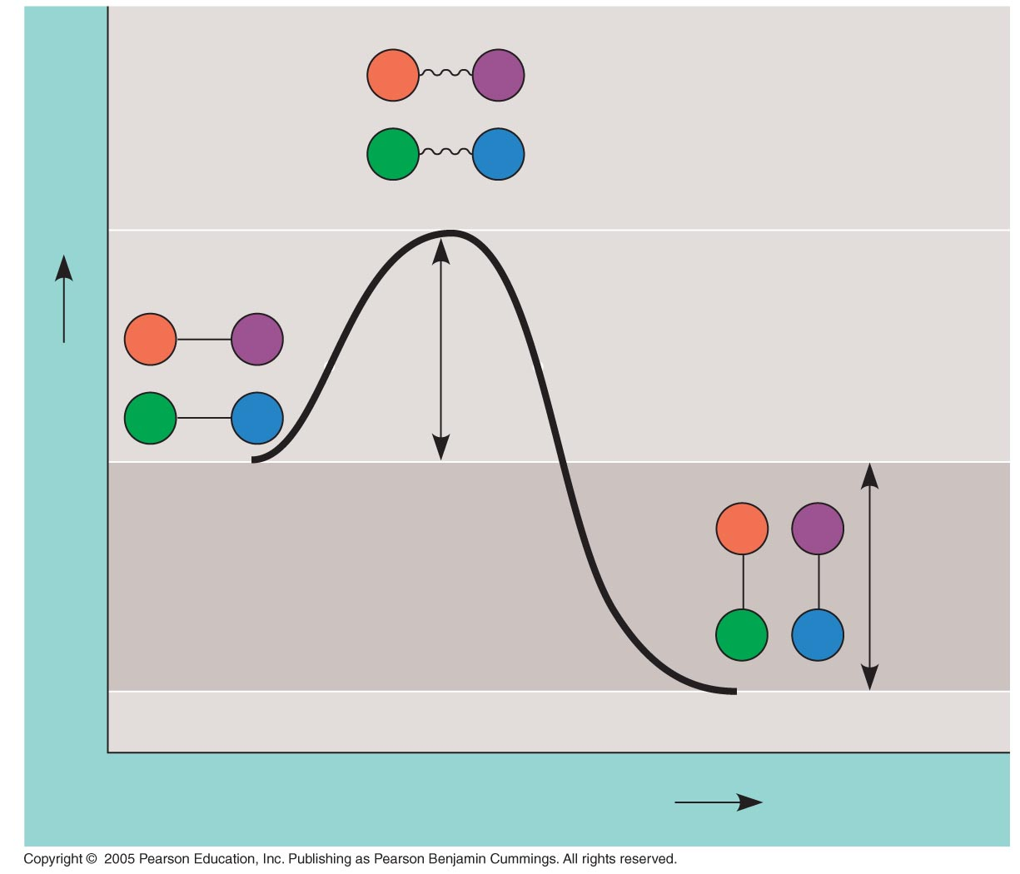
LE 8-14
A
B
C
D
Transition state
A
B
E_{A}
Free energy
D
C
Reactants
A
B
ΔG < O
C
D
Products
Progress of the reaction

Slide 20
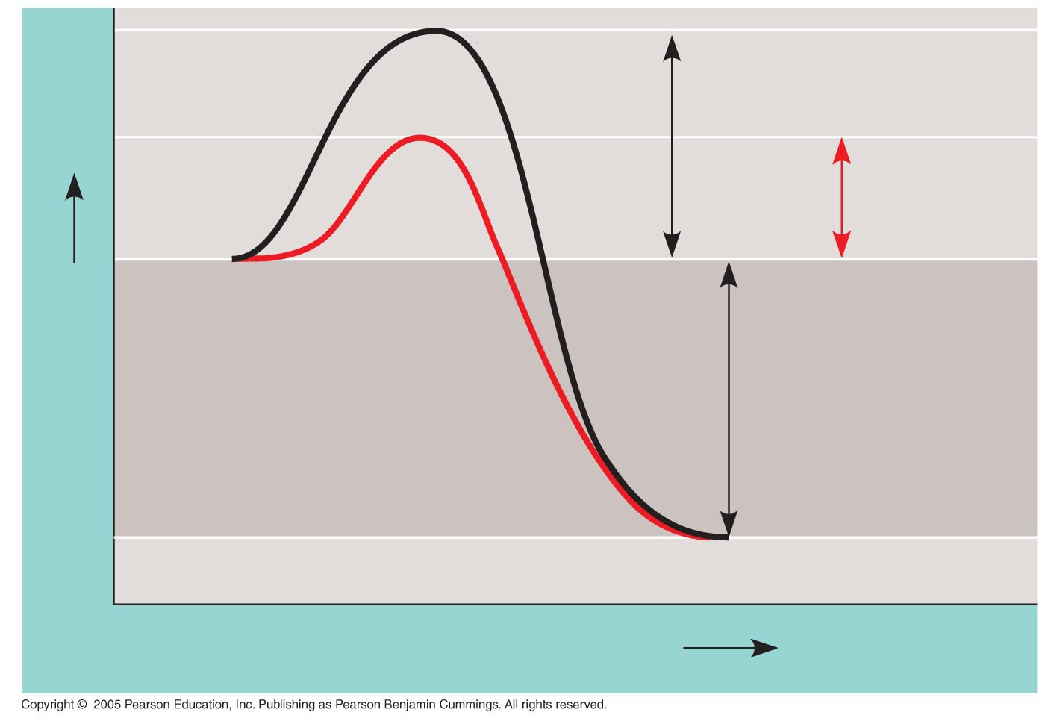
LE 8-15
Course of
reaction
without
enzyme
E_{A}
without
enzyme
E_{A} with
enzyme
is lower
Reactants
Free energy
Course of
reaction
with enzyme
ΔG is unaffected
by enzyme
Products
Progress of the reaction

Slide 21
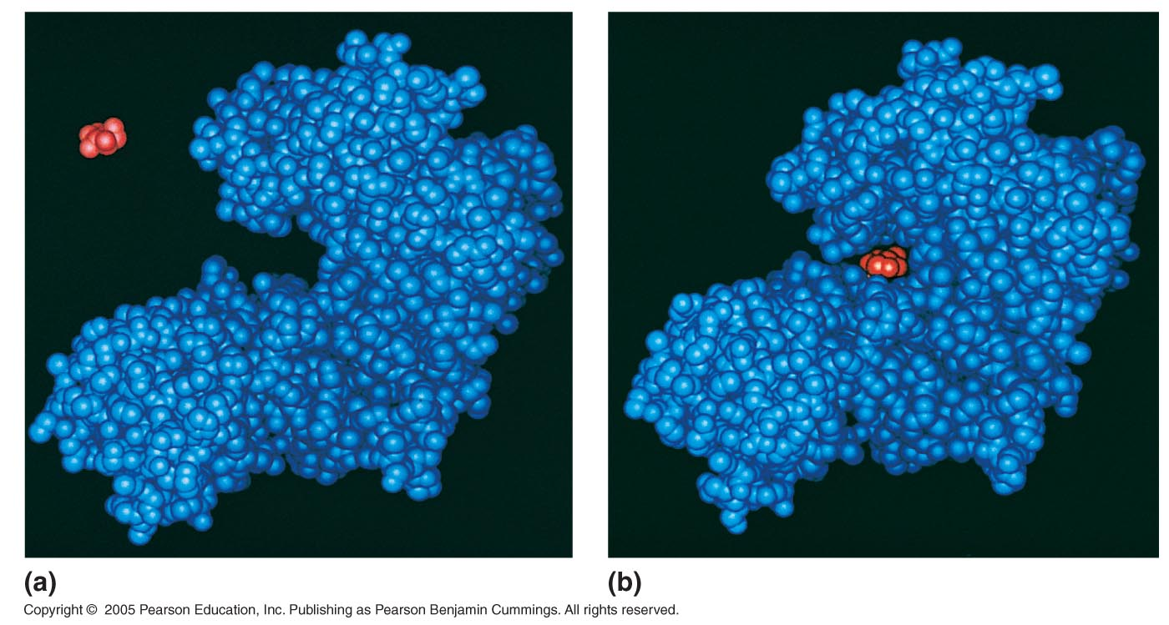
LE 8-16
Substrate
Active site
Enzyme
Enzyme-substrate
complex

Slide 22
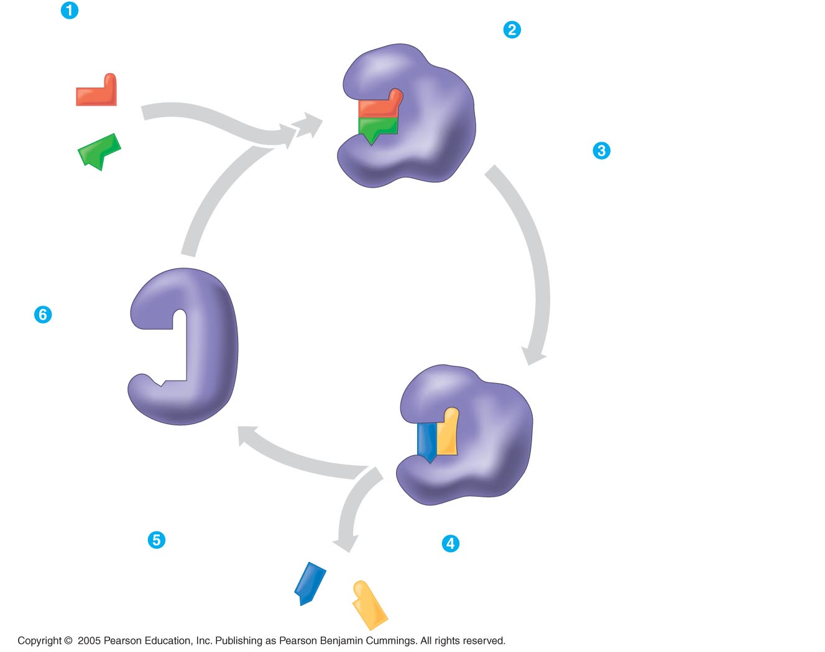
LE 8-17
Substrates enter active site; enzyme
changes shape so its active site
embraces the substrates (induced fit).
Substrates held in
active site by weak
interactions, such as
hydrogen bonds and
ionic bonds.
Active site (and R groups of
its amino acids) can lower E_{A}
and speed up a reaction by
acting as a template for
substrate orientation,
stressing the substrates
and stabilizing the
transition state,
providing a favorable
microenvironment,
participating directly in the
catalytic reaction.
Substrates
Enzyme-substrate
complex
Active
site is
available
for two new
substrate
molecules.
Enzyme
Products are
released.
Substrates are
converted into
products.
Products

Slide 23
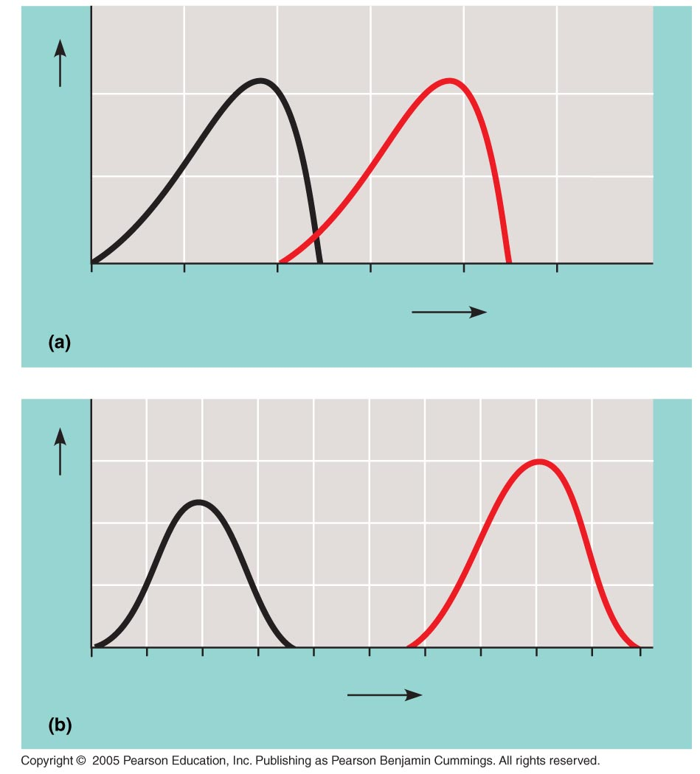
LE 8-18
Optimal temperature for
typical human enzyme
Optimal temperature for
enzyme of thermophilic
(heat-tolerant
bacteria
Rate of reaction
0
20
40
60
80
100
Temperature (°C)
Optimal temperature for two enzymes
Optimal pH for pepsin
(stomach enzyme)
Optimal pH
for trypsin
(intestinal
enzyme)
Rate of reaction
0
1
2
3
4
5
6
7
8
9
10
pH
Optimal pH for two enzymes

Slide 24
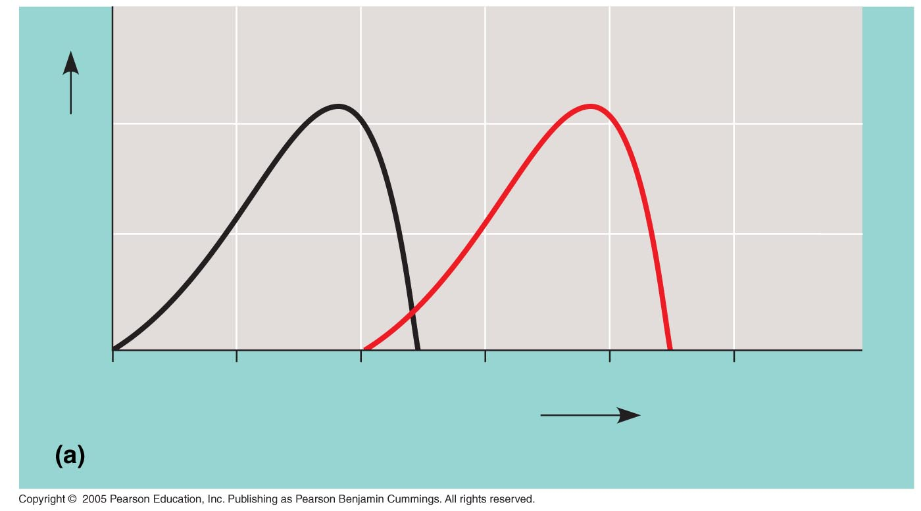
LE 8-18a
Optimal temperature for
typical human enzyme
Optimal temperature for
enzyme of thermophilic
(heat-tolerant
bacteria
Rate of reaction
0
20
40
60
80
100
Temperature (°C)
Optimal temperature for two enzymes

Slide 25
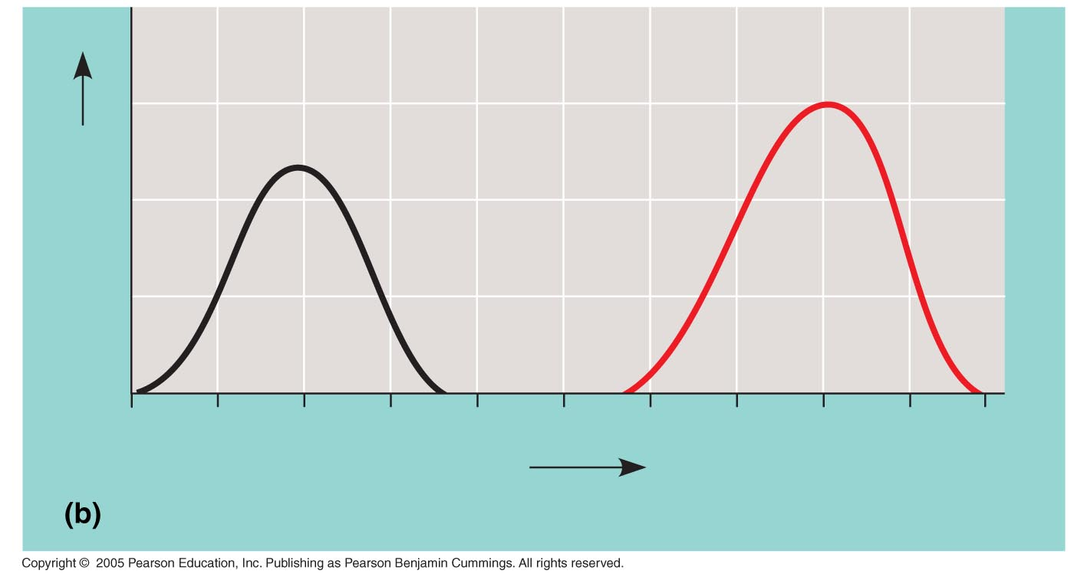
LE 8-18b
Optimal pH for pepsin
(stomach enzyme)
Optimal pH
for trypsin
(intestinal
enzyme)
Rate of reaction
0
1
2
3
4
5
6
7
8
9
10
pH
Optimal pH for two enzymes

Slide 26
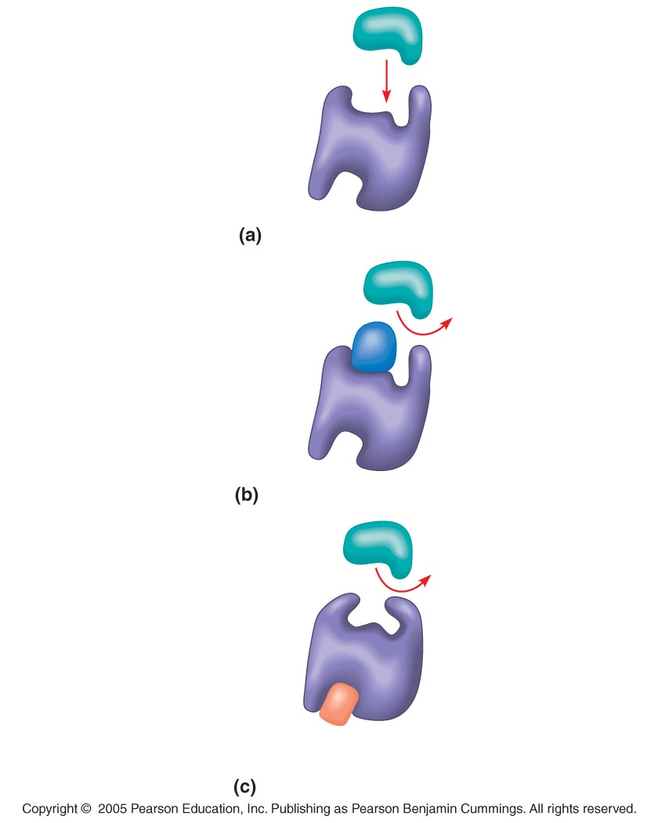
LE 8-19
A substrate can
bind normally to the
active site of an
enzyme.
Substrate
Active site
Enzyme
Normal binding
A competitive
inhibitor mimics the
substrate, competing
for the active site.
Competitive
inhibitor
Competitive inhibition
A noncompetitive
inhibitor binds to the
enzyme away from the
active site, altering the
conformation of the
enzyme so that its
active site no longer
functions.
Noncompetitive inhibitor
Noncompetitive inhibition

Slide 27
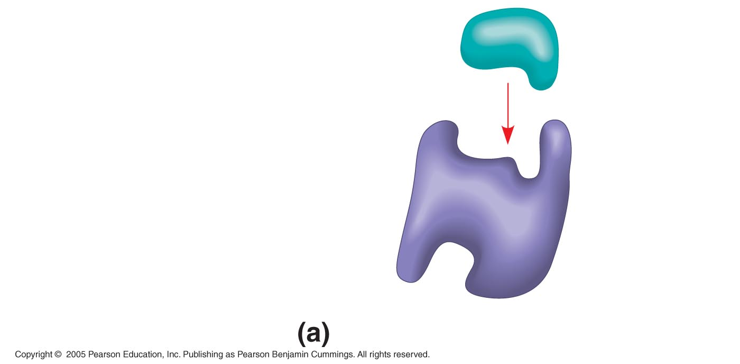
LE 8-19a
A substrate can
bind normally to the
active site of an
enzyme.
Substrate
Active site
Enzyme
Normal binding

Slide 28
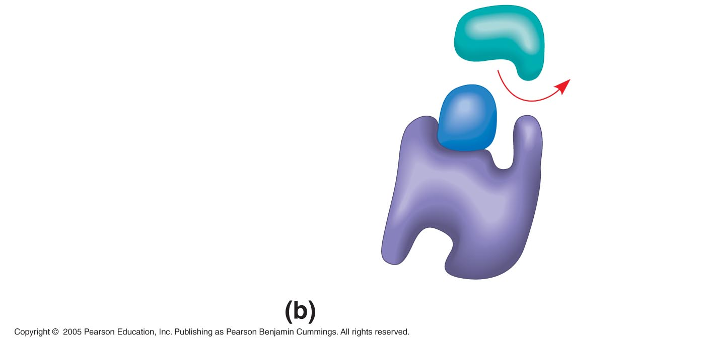
LE 8-19b
A competitive
inhibitor mimics the
substrate, competing
for the active site.
Competitive
inhibitor
Competitive inhibition

Slide 29
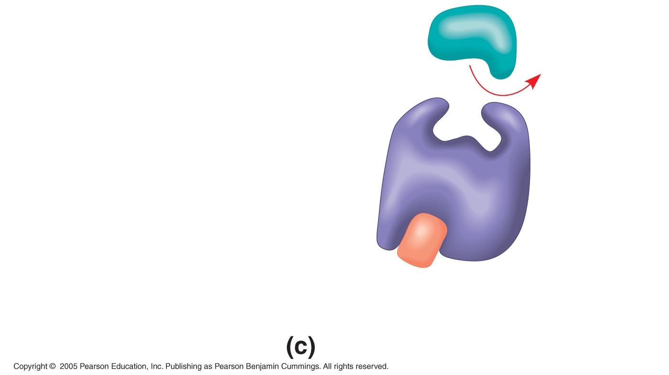
LE 8-19c
A noncompetitive
inhibitor binds to the
enzyme away from the
active site, altering the
conformation of the
enzyme so that its
active site no longer
functions.
Noncompetitive inhibitor
Noncompetitive inhibition

Slide 30
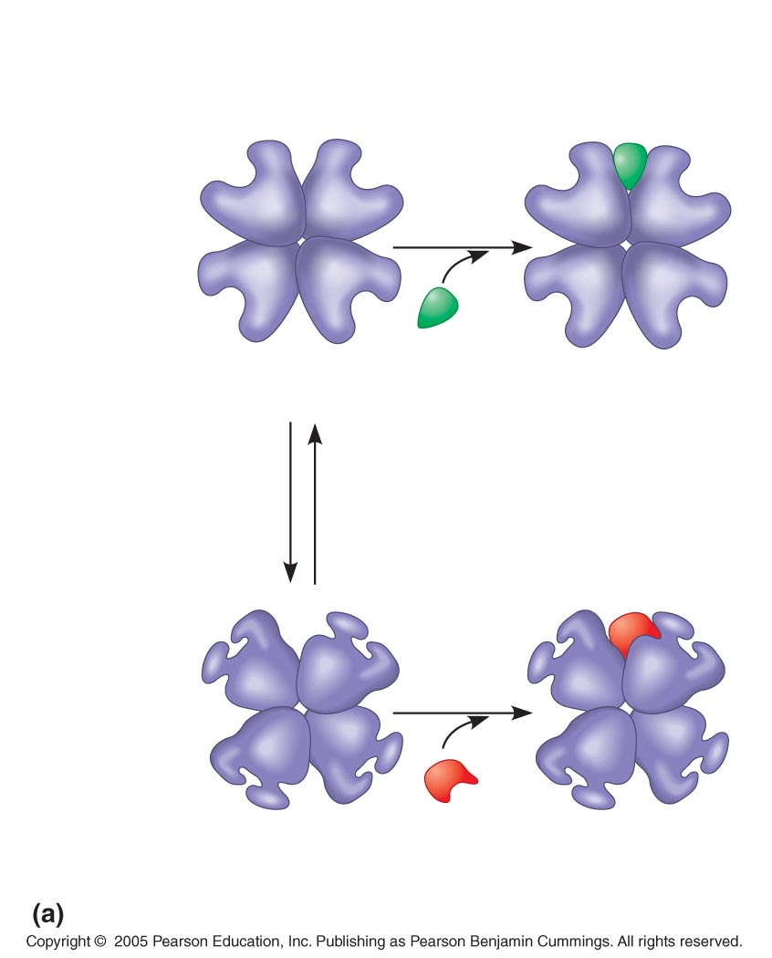
LE 8-20a
Allosteric activator
stabilizes active form.
Allosteric enzyme
with four subunits
Active site
(one of four)
Regulatory
site (one
of four)
Activator
Active form
Stabilized active form
Oscillation
Allosteric inhibitor
stabilizes inactive form.
Non-
functional
active site
Inactive form
Inhibitor
Stabilized inactive
form
Allosteric activators and inhibitors

Slide 31
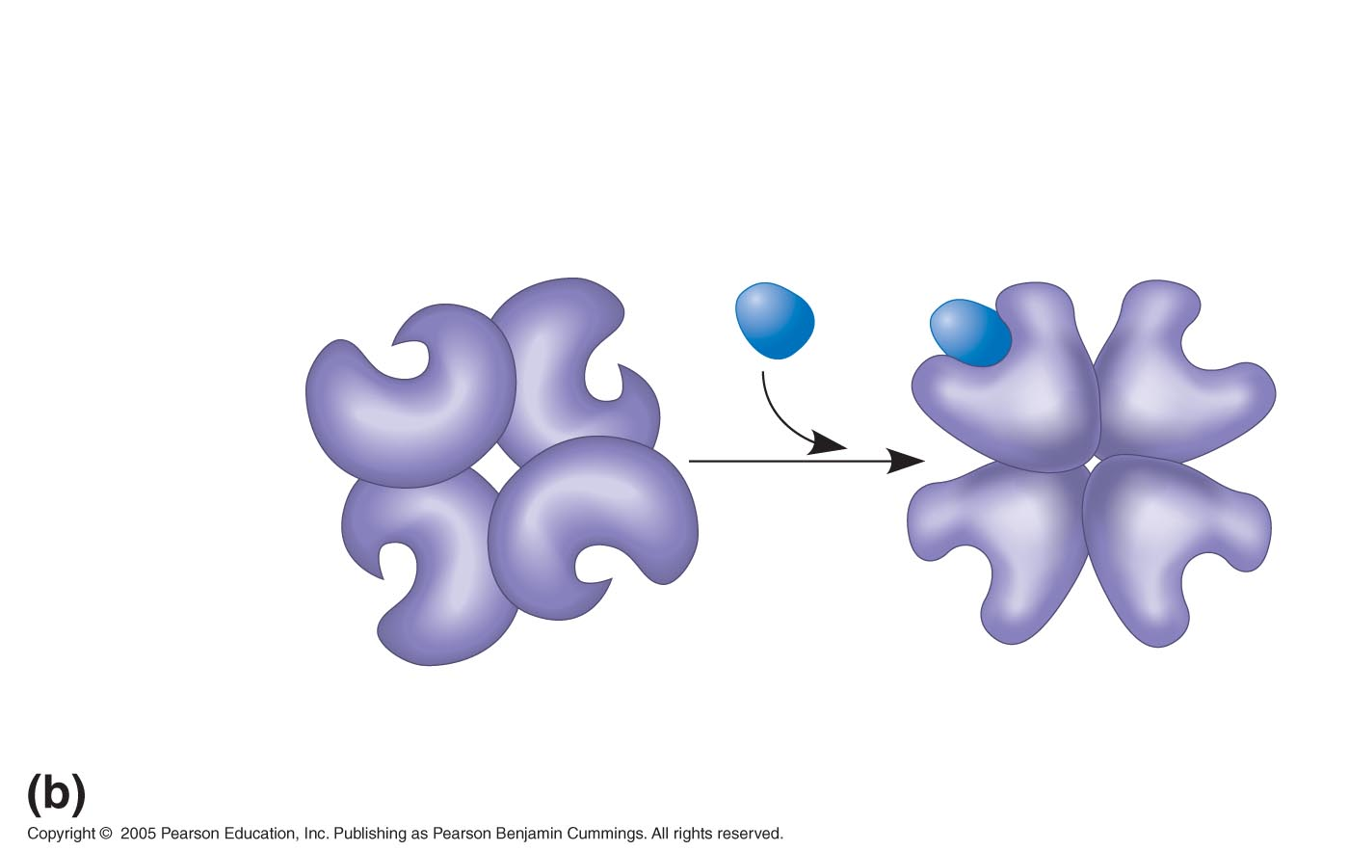
LE 8-20b
Binding of one substrate molecule to
active site of one subunit locks all
subunits in active conformation.
Substrate
Inactive form
Stabilized active form
Cooperativity another type of allosteric activation

Slide 32
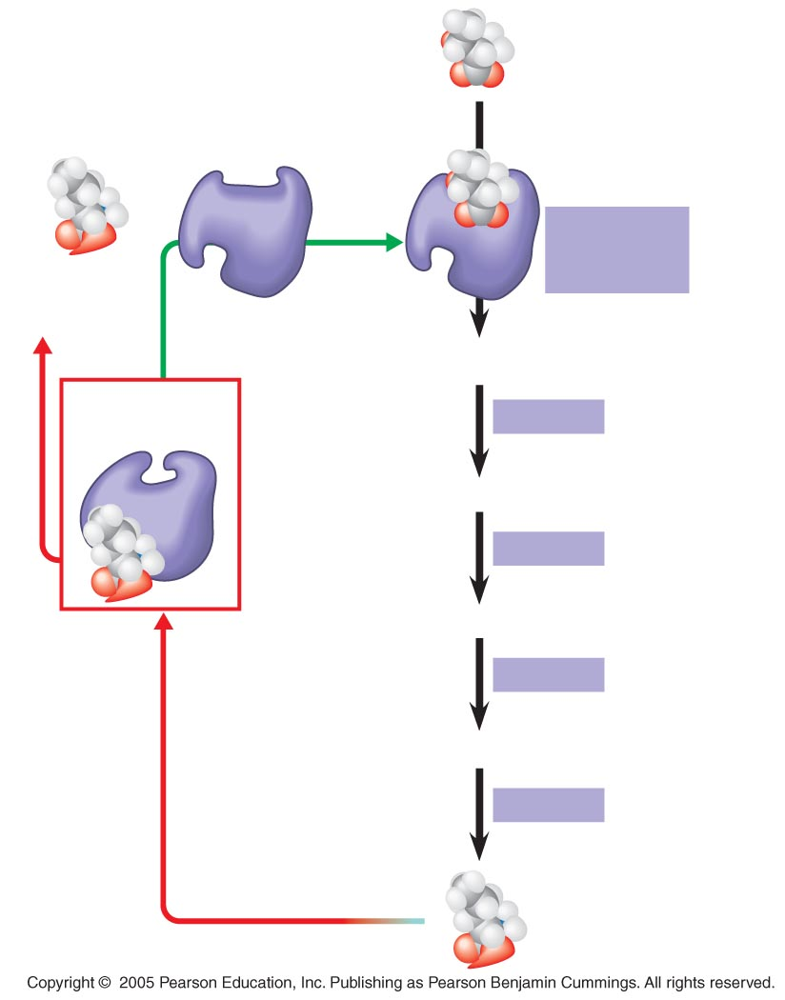
LE 8-21
Initial substrate
(threonine)
Active site
available
Threonine
in active site
Enzyme 1
(threonine
deaminase)
Isoleucine
used up by
cell
Intermediate A
Feedback
inhibition
Enzyme 2
Active site of
enzyme 1 can’t
bind
theonine
pathway off
Intermediate B
Enzyme 3
Isoleucine
binds to
allosteric
site
Intermediate C
Enzyme 4
Intermediate D
Enzyme 5
End product
(isoleucine)

Slide 33
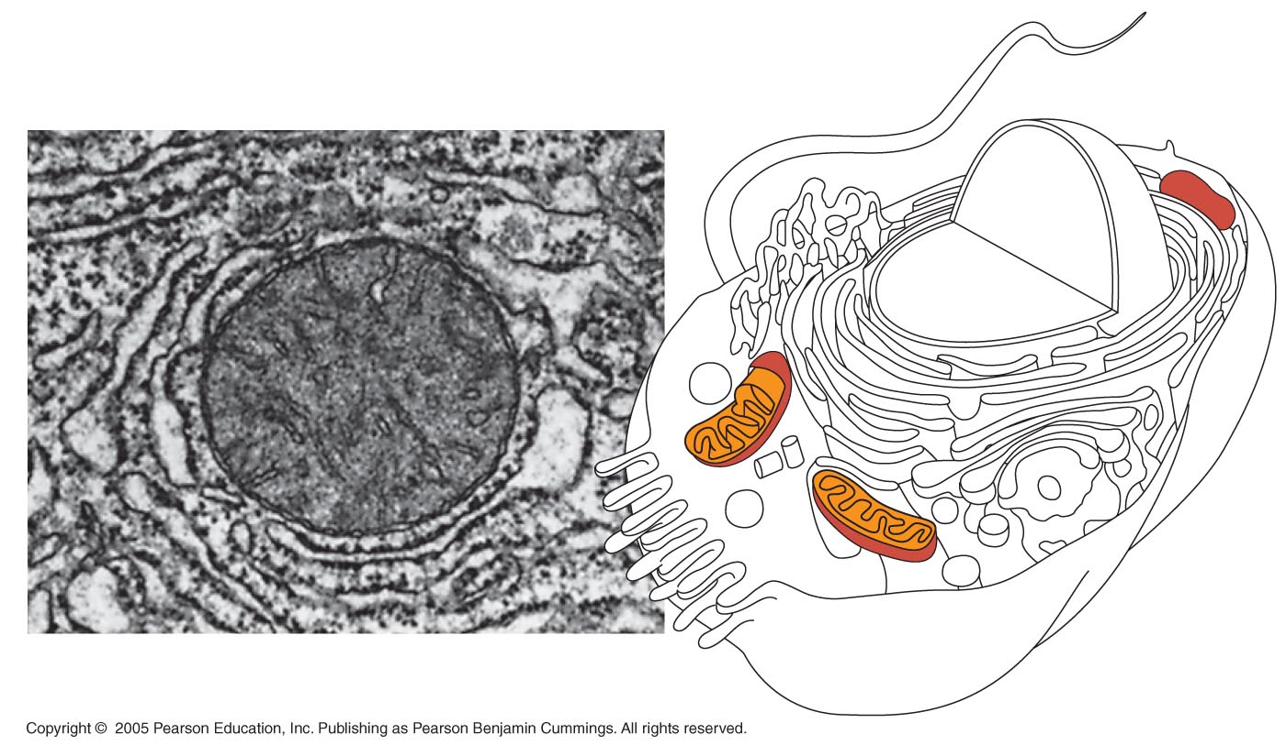
LE 8-22
Mitochondria,
sites of cellular respiration
1 µm

Slide 34
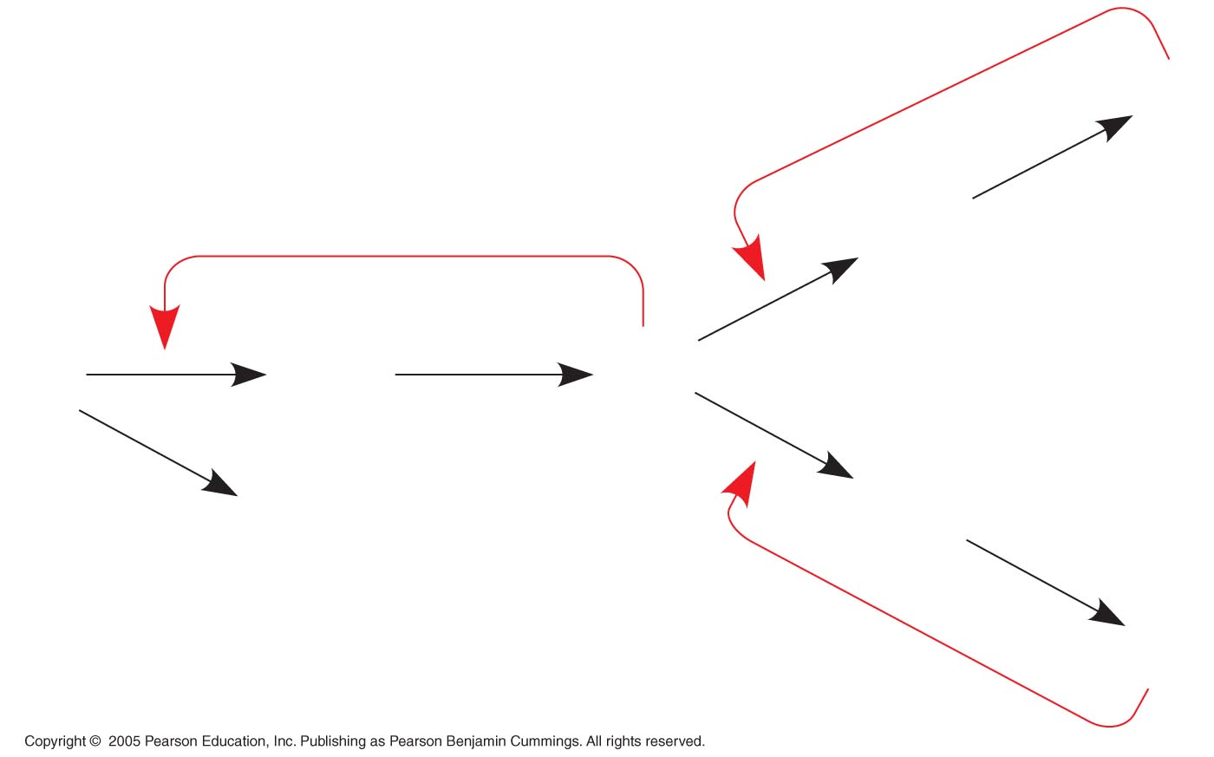
LE 8-UN159
–
Q
–
P
L
M
O
N
R
S
–

